Slide 1
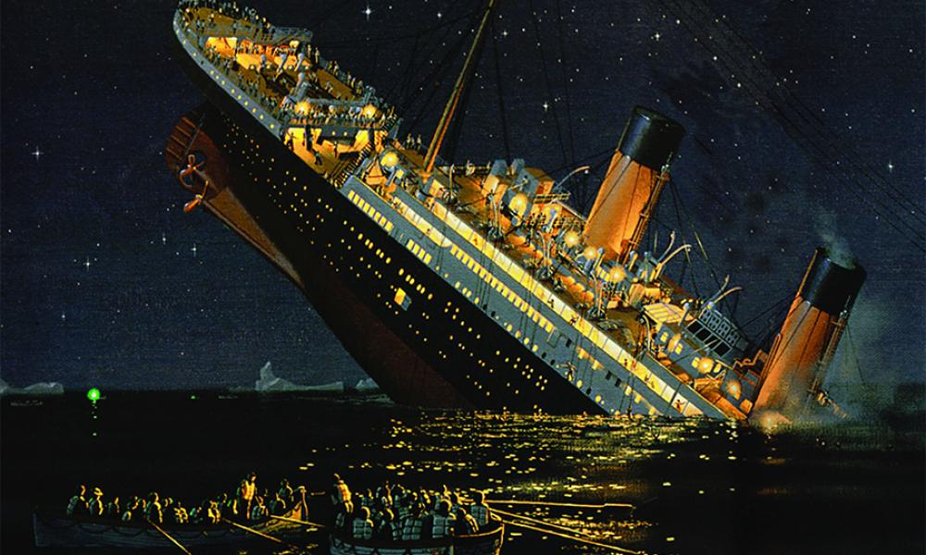
Data analysis and machine Learning on Titanic dataset
Course : Fundamentals of AI
Professor : Alina Vereshchaka
Presenter :Rahul Shinde(Team 15)
Date : 11/17/2021

Slide 2
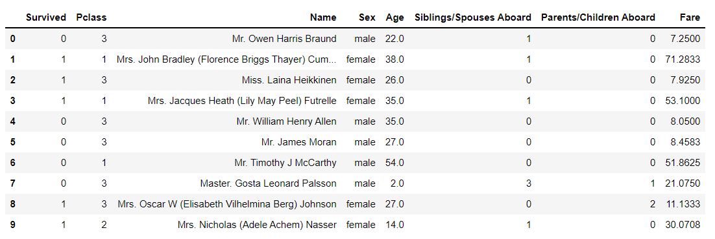
Dataset
It has 887 entries, 8 features, it consist of float, int and object datatypes.Moreover, it does not have any missing values.

Slide 3
EXPLORATORY DATA ANALYSIS
.

Slide 4
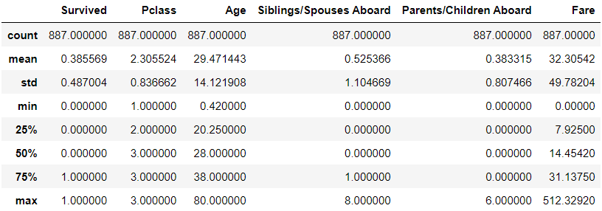
Statistical Inference of the Dataset

Slide 5
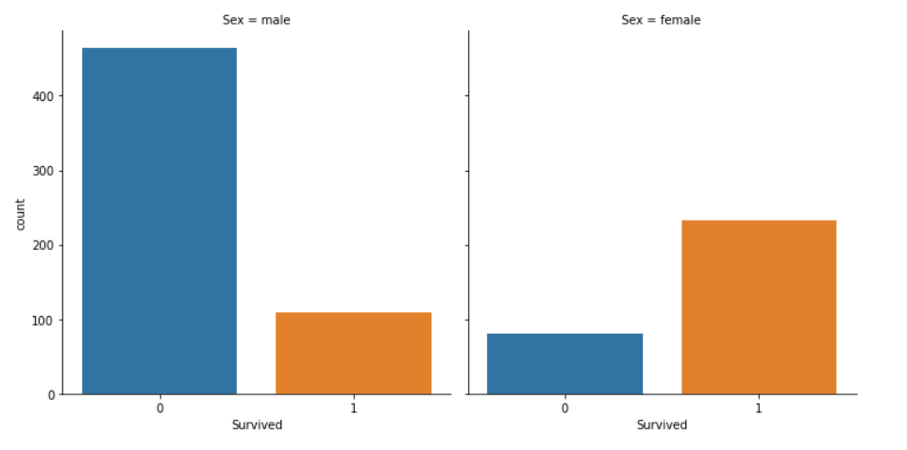
From the above graph we can see that female survivors were more than male survivors when the incident took place.

Slide 6
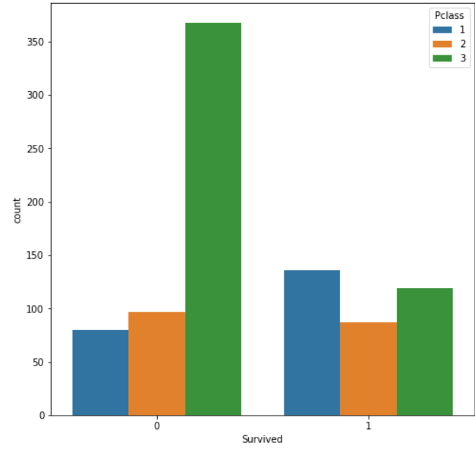
People who travelled in class 3 were more likely to survive.

Slide 7
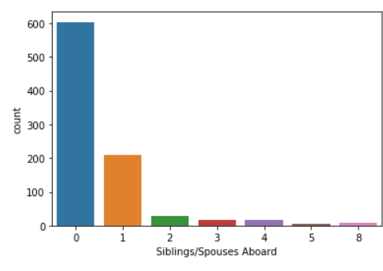
Most of the passengers on the Titanic were travelling alone.

Slide 8
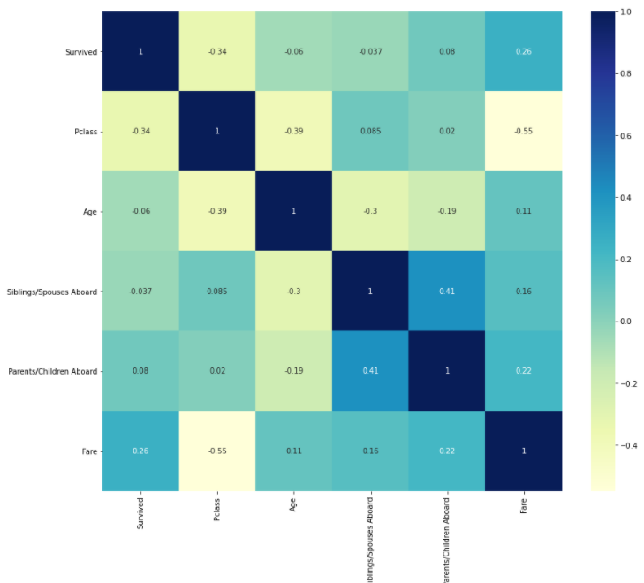
CORRELATION BETWEEN THE VARIABLES
Siblings/Spouses Aboard
and Parents/Child Aboard
are correlated at some extent,
but not that strongly correlated.

Slide 9
DATA PREPROCESSING
Deleted "Name" column because of its less significance.
Applied dummy variables on "Sex" and "Pclass" columns due to there categorical nature.
Applied MinMaxScalar on the independent variables
after splitting the dataset in training and testing.

Slide 10
MACHINE LEARNING ANALYSIS

Slide 11
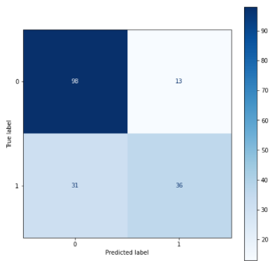
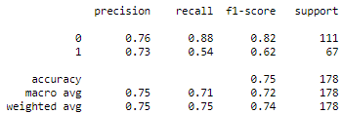
1. LOGISTIC REGRESSION
Logistic regression is a statistical analysis method used to predict a data value based on prior observations of a data set.A logistic regression model predicts a dependent data variable by analyzing the relationship between one or more existing independent variables.
There are 13+31 = 44 wrong predictions.
Model performs with 75% accuracy.

Slide 12
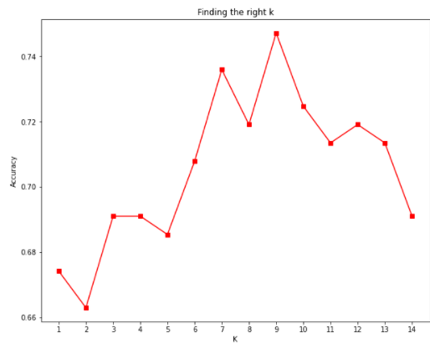
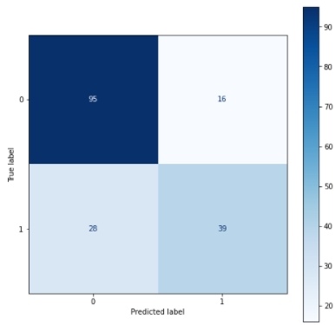
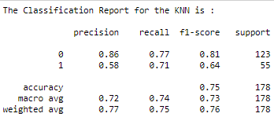
2. KNN
The k-nearest neighbors (KNN) algorithm is a simple, supervised machine learning algorithm that can be used to solve both classification and regression problems. It's easy to implement and understand, but has a major drawback of becoming significantly slows as the size of that data in use grows.
Best value for k is 9.
There are 28 + 16 = 44 wrong predictions.
KNN performed with 75% accuracy.

Slide 13
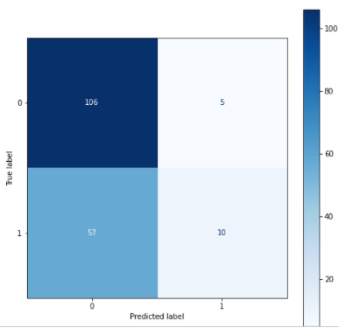
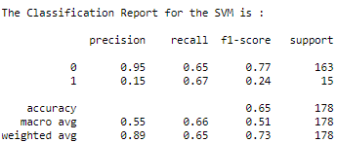
3. SUPPORT VECTOR MACHINE
A support vector machine (SVM) is machine learning algorithm that analyzes data for classification and regression analysis. SVM is a supervised learning method that looks at data and sorts it into one of two categories. An SVM outputs a map of the sorted data with the margins between the two as far apart as possible.
There are 57 + 5 = 62 wrong predictions.
SVM performed with 65% accuracy.

Slide 14
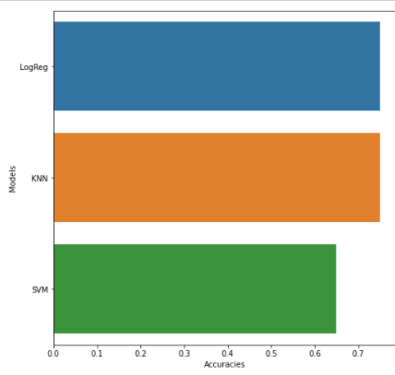

MODEL COMPARISON
From the above graph we can see that Logistic Regression and K Nearest Neighbors performs better than Support Vector Machine on Titanic Dataset with 75% accuracy.

Slide 15
DEEP LEARNING ANALYSIS

Slide 16
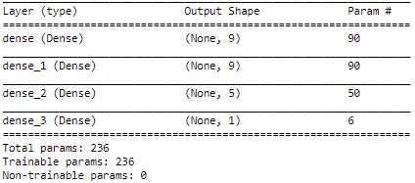
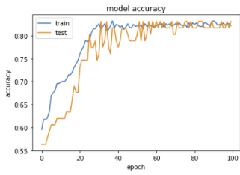
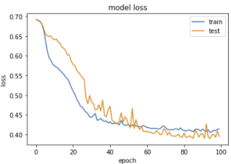
1. Activation : Relu, Optimizer : Adam, Loss = Binary Crossentrophy,
BatchSize = 32, epochs : 100

Slide 17
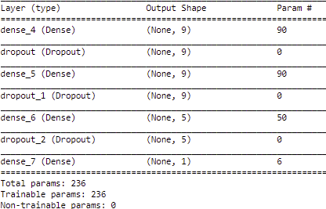
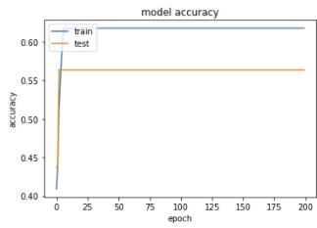
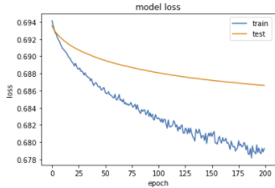
2. Activation : Softmax, Optimizer : Adagrad,
Loss = BinaryCrossentrophy,Dropout = 0.50, BatchSize = 32, epochs :200

Slide 18
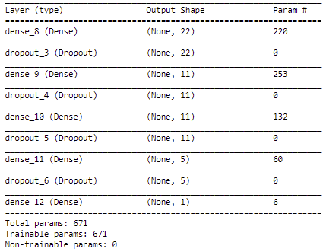
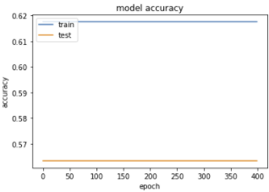
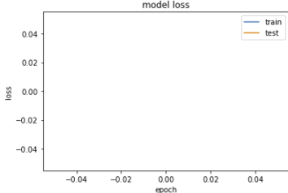
3. Activation : Tahn, Optimizer : Adadelta,Loss = Categorical Crossentrophy,
BatchSize = 32, epochs :400

Slide 19
QUESTIONS ????

Slide 20
THANK YOU

